Slide 1

Material
https://github.com/caisr-hh/handson_mlflow_optuna

Slide 2
Tutorial on Systems Over Models: What Actually Works in Industry (SOMI-2026)

Slide 3
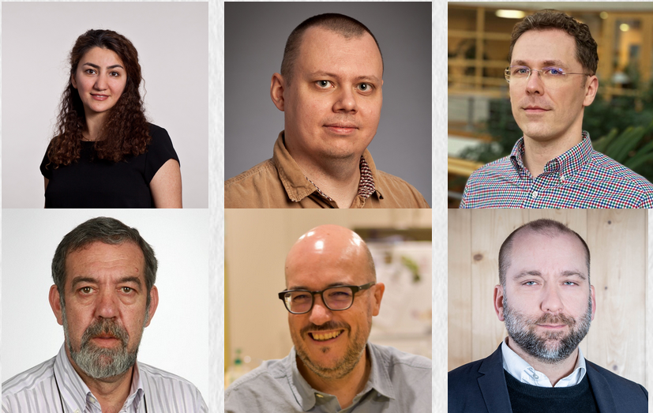
Organizers
Zahra Taghiyarrenani, CAISR, Halmstad University, Sweden
Slawomir Nowaczyk, CAISR, Halmstad University, Sweden
Maciej Misiorny, Sigma Technology Insight Solutions, Sweden
Joao Gama, University of Porto, Portugal
Albert Bifet, Waikato University, New Zealand
Martin Atzmüller, Osnabrück University, Germany

Slide 4
Introducing ourselves
Halmstad University: A Swedish university with great ambitions when it comes to turning cutting edge research into the mundanity of the future.
Slawomir Nowaczyk: Professor at Halmstad University at CAISR, the centre for applied intelligent systems research.
Mikael Andersson: Research engineer at H.U. working in the academic-industrial intersection for Volvo and Cetasol.

Slide 5
Prelude
Notes on industrial collaborations

Slide 6
Why are we hosting Systems over Models?
The project appeared to go well, everyone was doing their job, papers got written, hands were shaken.
And then you never heard from them again?
What happened after you left?
You might be experiencing
the silent death of a project.

Slide 7

Friction
These collaborations have plenty of friction due to different values and focus:
Novelty/track record
Pushing benchmarks/good enough
Public/private
Economy and hardware
Handing it over…

Slide 8
The specialist issue
Ensure your team is robust, and that it can survive without you…
More overlap is needed.
Besides, frameworks that encourages systematic workflows has a tendency to help the individual as well.

Slide 9
Our goals for today's tutorials
Part I:
  Introduce you to tools that can be easily integrated into your current workflow yet also impact how you structure your projects in the future:
    Exploring the parameter space with Optuna.
    Managing your growing experiments with Mlflow.
Part II:
  Show you how these tools come together in a manageable Databricks microcosmos, a mock production environment with reproducibility, configuration driven design and a farm to table overview of working in system.
  Practice thinking in terms of systems, not just models.

Slide 10
Part 1- Tools of the trade
Exploring Mlflow and Optuna

Slide 11
Hyperparameter selection (Optuna)
“Quis parametros ipsos parametrizat?”
Optuna is a library for hyperparameter optimization that attempts to go beyond grid or random searches by modelling the statistical importance of the parameters over several training runs.
We initialize a study that orchestrates this optimization process and define objectives that return the final metric we are optimizing. Over time the trials should sample from a more ideal set of hyperparameter than doing so randomly.
Also has a GUI thanks to optuna-dashboard!

Slide 12
Studies
A Study is a collection of different objectives being optimized.
  study = Optuna.create_study(
  str storage=None, <Storage for trials, if None uses in memory storage.
  pruner=None, <Optuna pruner if so desired, we will return to this.
  str study_name=None, <Study name, generated automatically if left empty.
  str direction=None, <Trying to “minimize” or “maximize” metric?
  bool load_if_exists=False, <Return existing study with same name?
  [str] directions=None <List of directions for multiple objectives.
  )
Yields an optuna.study.Study object...

Slide 13
Studies
…That can be optimized:
study.optimize(
func, <Objective function to optimize.
int n_trials=None, <Number of trials to run.
float timeout= None <Maximum time allowed to optimize study.
)
(Additional arguments available…)

Slide 14
Suggest
For each new trial, the suggest methods invoked inside the objective provides an informed guess as to what parameters influences the objective metrics in the desired directions.
  Trial.suggest_float(string name, float low, float high, float step=None, bool log=False)
  Trial.suggest_int(string name, float low, float high, float step=None, bool log=False)
  Trial.suggest_categorical(string name, float low, float high)

Slide 15
Objectives
Define an objective function that returns the metric(s) being maximized/minimized.
You may use an individual objective function or define it as a method on a class which can be useful for handling additional parameters and configurations inside the objective function.
The function should have a trial argument which passes a trial object that handles the current optimization attempt.
Ex: Loss, accuracy, additional costs in time or resources.

Slide 16
Ex: Defining our objective
    def objective(trial : optuna.trial.Trial):
    number_of_layers = trial.suggest_int(name=“n_layers”, low = 1, high = 5)
    dropout = trial.suggest_float(name=“dropout”, low = 0.0, high = 0.5)
    learning_rate = trial.suggest_float(name="learning_rate", low = 1e-5, high= 1e-2, log = True)
    model = my_model(number_of_layers,dropout,learning_rate)
    result = model.train()
    return(result)

Slide 17
Ex: Defining and running our study
    study=optuna.create_study(direction=“minimize”)
    study.optimize(objective, n_trials=50)
    And if you want to get the winner:
    winner = Study.best_trial

Slide 18
Optuna dashboard
Optuna-dashboard is a python package that allows you to host a GUI for optuna studies, allowing for manual management and inspection.
To host optuna dashboard using sqlite storage you may open a terminal and run:
optuna-dashboard --host address –port portnumber sqlite:///databasename.db
For now, consider hosting using:
optuna-dashboard sqlite:///optuna.db
The UI should now be accessible through your browser.

Slide 19
Demo script 1: Optimizing with optuna.
The study, objective and trial system is flexible, allowing flexible integration with most frameworks or to solve optimization problems on its own.
An example has been provided in optuna_optimize.py in search for the border by means of constants k,m for y = k*x+m

Slide 20
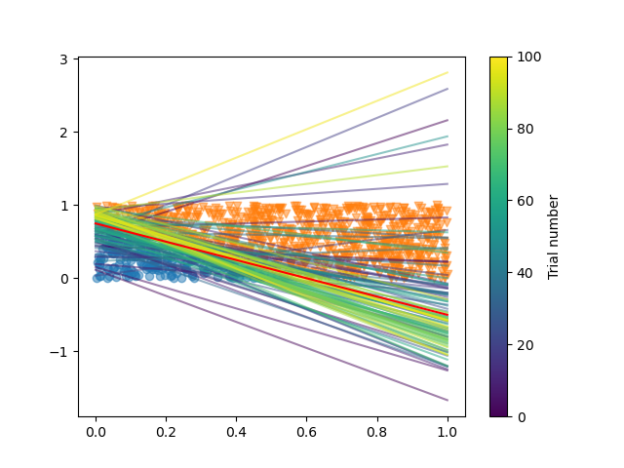
The result:
Truth in red.

Slide 21
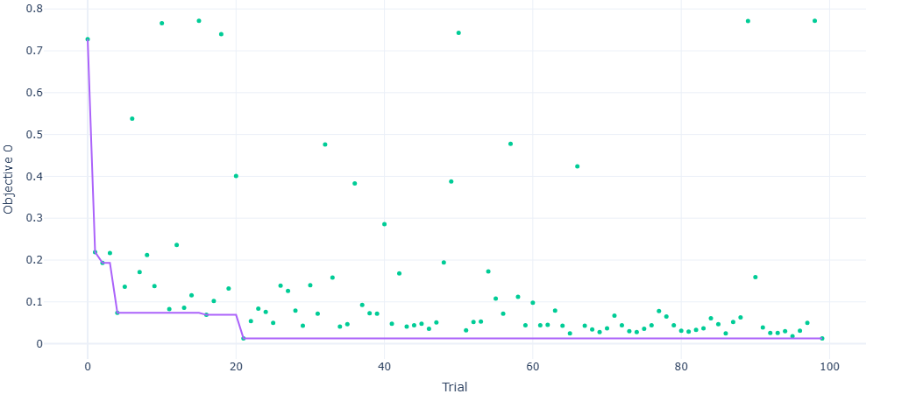
The result:
Objective value for the study, blue is best trial result, green is individual trials.

Slide 22
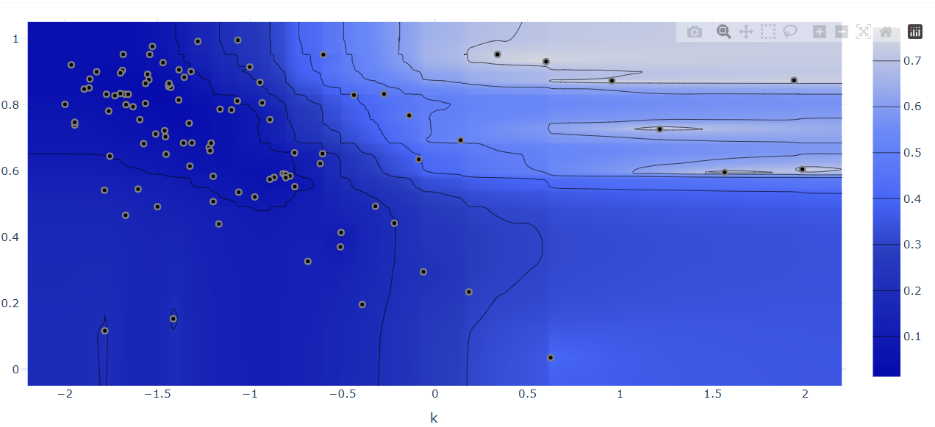
The result:
K vs M and the value map.

Slide 23
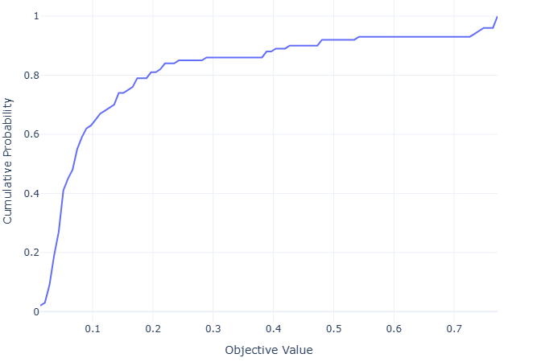
The result:
Cumulative probability for objective values .

Slide 24

Pruning
To save on both time and computational resources, optuna supports termination of trials that does not show promise in the early stages of training.
Various pruning methods are available such as hyperband pruning, percentile pruning etc.
In our tutorial we will be using the median pruner, comparing the median of the metric across trials for a given timestep.

Slide 25
Pruning
We pass the pruner to optuna.create_study(pruner=optuna.pruners.MedianPruner)
In between epochs or batches, we may report the metric we want to prune based on (for example validation loss at each epoch) using:
trial.report(current_value, epoch)
Then, the training loop can be terminated based on the condition that:
trial.should_prune()==True

Slide 26
Pruning
We pass the pruner to the study we are creating:
optuna.create_study(pruner=my_pruner)
In between epochs or batches, we may report the metric we want to prune based on (for example validation loss at each epoch) using:
trial.report(current_value, epoch)
Then, the training loop can be terminated based on the condition that:
trial.should_prune()==True

Slide 27
Demo script 2: Pruning
Let us now look at training a small neural network to classify nested rings by running optuna_pruning.py.
(yes, I know).
We will use this simple problem and solution to show how easy it is to integrate optuna within your current project and the effects of pruning.

Slide 28
Experiment tracking (MLFlow)
MLFlow is a flexible platform allowing you to track and log your model in real-time locally or to shared servers, with various features supporting the evaluation, packaging, and deploying your models.
It has become a commonly used tool within the industry, but while it shines in a team setting it also makes working with large sets of models and experiments a lot more manageable for the individual as well.

Slide 29
General structure
Experiments: Separate different projects on the same server by logging them to different experiments. Can be identified by name string or int.
Runs: Each training instance can be set to generate runs individually or as children to a parent run, useful with Optuna HPO. Each run has its own unique runID.
Models: The direct machine learning product of your runs, models have an independent existence to their originating run in MLflow 3.

Slide 30
Setting up the MLFlow tracking server
In a team setting you will usually work with a shared mlflow server, but for this exercise we will be hosting a local server of our own.
To set up the server for our exercise, open your terminal in the project root and activate the environment, then run:
mlflow server --backend-store-uri sqlite:///mlflow.db --port 5000

Slide 31
Connecting to mlflow in your code:
Set the uri with: mlflow.set_tracking_uri(”uri”).
Set the active experiment with mlflow.set_experiment(”experimentname”)
Ex:
mlflow.set_tracking_uri(http://127.0.0.1:5000)
mlflow.set_experiment(”my_experiment”)

Slide 32
MLFlow logging
Parameters: We may log parameters of our choice using:
  mlflow.log_param(str key, value) <For a single parameter.
  mlflow.log_params(dict key,_value_dict) <For multiple parameters in a batch.
Metrics: For metrics we may also want to include information such as which training step we are in:
  mlflow.log_metric(str key, value, int step)
  mlflow.log_metrics(dict key_, value_dict)

Slide 33
MLFlow logging
Artifacts: The relevant products of our training. This can include everything from model parameters to figures generated by the evaluation step. These are stored according to the server’s artifact storage, under the attached run.
  mlflow.log_figure(fig, file_path) <Store a figure.
  mlflow.log_text(fig, file_path) <Store a text.

Slide 34
Active run
If creating a run, then within that scope, logging functions without the runID specified will default to logging under that run.
EX, creating a run and setting the ”Hello” tag to ”World!:
mlflow.set_tracking_uri(http://127.0.0.1:5000)
mlflow.set_experiment(”my_experiment”)
with mlflow.start_run() as run:
mlflow.set_tag(key="Hello", value="World!")
model.train_and_log()

Slide 35
Demo script 3: Logging to MLFlow
Covers:
Connecting to MLFlow.
Logging:
  Tags.
  Parameters.
  Artifacts.

Slide 36
MLFlow models
When logging a model in mlflow with mlflow.log_model a new model artifact is generated (under the runs models). These can be added globally to the model registry and served by mlflow models or in a container.
When logging our models we can provide an input-output signature, package the source files and define the requirements, environment etc.

Slide 37
Serving a registered model
NOTE! We need to set an environment variable pointing at our tracking server to connect the model server. Before using serve in , run the command:
(windows:) set MLFLOW_TRACKING_URI <tracker host>:<tracker port>
(linux/mac:) export MLFLOW_TRACKING_URI= <tracker host>:<tracker port>
Ex: set MLFLOW_TRACKING_URI http://127.0.0.1:5000

Slide 38
Serving a registered model
With a model in the mlflow registry we may also quickly generate docker images for to test deployment with:
mlflow models build-docker –m ”models:/modelname/version” –n imagename
We may also host a local server using mlflow command line with:
mlflow models serve -m "models:/modelname/version" -p port

Slide 39
Serving a registered model
In our exercise (running with default names and configurations) this will be:
mlflow models serve -m "models:/registered_models/latest" --no-conda -p 5001
(Where we disable the environment setup using –no-conda due to working in an environment already set up for the project.)

Slide 40
In summary:
Optuna is your friend for exploring the hyperparameter space.
Mlflow manages your growing collection of experiments and offer flexible features for managing their lifecycle.
Let us now take a break!

Slide 41
https://github.com/caisr-hh/handson_mlflow_optuna

